Slide 1
{acs_course_eng}
{eng_lang}
ACS(BL)(Exp)-PP-01, Ver 1.08, Rev 08, 09-02-2023
Competency Code:{competency_code}

Slide 2


{ground_rule}
{ground_rule_1}
{ground_rule_2}
{ground_rule_3}
{ground_rule_4}
{ground_rule_5}
{ground_rule_6}
{ground_rule_7}
{ground_rule_8}
{ground_rule_9}

Slide 3
Training and Assessment
Attendance:
100%
Training duration:
{tr_duration hours} hours
Including 2 hours
assessment
Written_test(Close_book_Individual}
{total_mcq} MCQ questions (40 marks)}
Duration:{hrs} hour
Pass criteria: 60% (Minimum of 24 marks)
Practical Performance
7 stations (PPE, Safety Sign, O2 entry limits for confined space, Fire Emergency, Ascend scaffold, Ascend roof structure and self-relief suspension trauma management)
Pass criteria: 100% (competency based)
> 3 components NYC, considered NYC of the course
Up to 3 components NYC, Trainer will teach and assess learner for 2nd attempt of that (NYC) components. During 2nd attempt, if any 1 component NYC, considered full course NYC.
Candidates must pass both the (MCQ) and Practical Performance separately

Slide 4
Training and Assessment
Trainee must be physically/medically fit to do this course.
Trainee need to declare the physical and Medical fitness in the Indemnity Form.
The course involves theory & practical training and practical examination (Example : Climbing a scaffold structure, Hanging in a Safety Harness etc..)
The trainee MUST BRING “Safety Shoe” and Long Pants for the Practical training and practical examination.
Safety Helmet and Full body Safety Harness will be provided

Slide 5
Examination Rules
Present at examination venue in time.
Follow the instructions of the invigilator/assessor
Using mobile phone/electronics devises are prohibited during exam. Switch off/silence your mobile phone
Keep your NRIC/Work Permit on the table. Invigilator will check your identity
Remove bags, books, mobile phone or any other personal belongings from the table. Keep in front /behind of the classroom.
Must use pen for written exam and use pencil to shade circle for MCQ exam
Write the question set number on the answer sheet
Learner and Invigilator Signature on the answer sheet
Don’t write/mark anything on the question paper
START and END time will be written on the white board. No extra time will be given for the exam.
Return answer sheet, exam paper and stationery to invigilator
Any types of cheating will not be allowed during exam and if do so by any candidate will be awarded “Zero Mark” or “NYC” immediately
Refer to the “Examination Rules” displayed in the classroom for details

Slide 6
Assessment result and Certificate
Result will be published at the end of the course and Certificate will be distributed to the Competent learners.

Slide 7

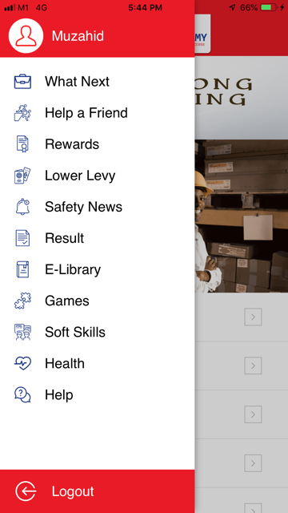

You may check the result from Eversafe App
1. Download App
2. Click here
3. Click Result

Slide 8
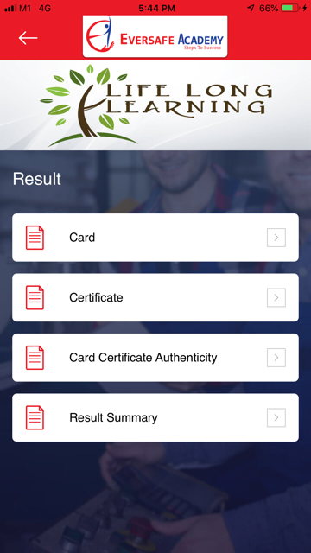

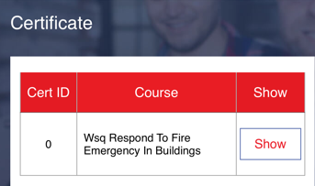
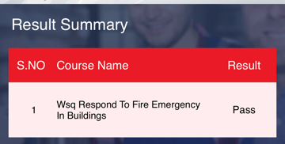
You may check the result from Eversafe App
Click
Card > Show
Scan QR Code on Card/Certificate

Slide 9

VIDE0

Slide 10
Login to the student’s e-learning portal
Visit www.eversafe.com.sg > click login > Choose Blended Learning-Student >User Name: NRIC/FIN > Show my login link> Go to my page
From computer
From mobile phone
Step 1- go to website “www.eversafe.com.sg”
Step 1- go to website “www.eversafe.com.sg”
Step 1a- click here, scroll down
Step 2- click login
Step 2- Click “Login”

Slide 11
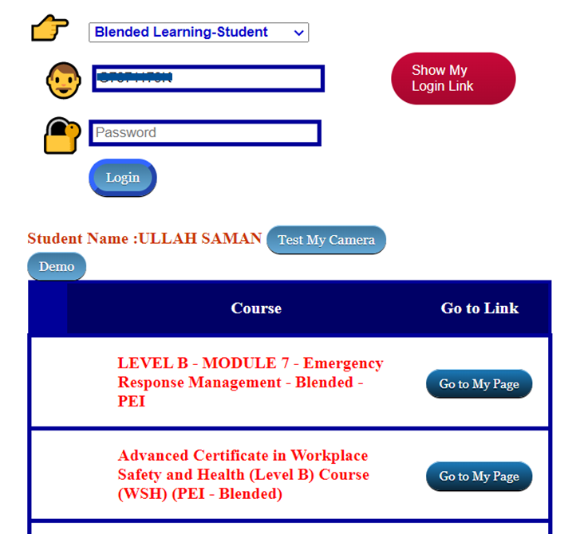
Login to the student’s e-learning portal
Visit www.eversafe.com.sg > click login > Choose Blended Learning-Student >User Name: NRIC/FIN > Show my login link> Go to my page
Step 3- click “Blended Learning- Student” from the list
Step 4- write NRIC/FIN
Step 5- click here
Step 6- Check course name and click “Go to My Page”

Slide 12


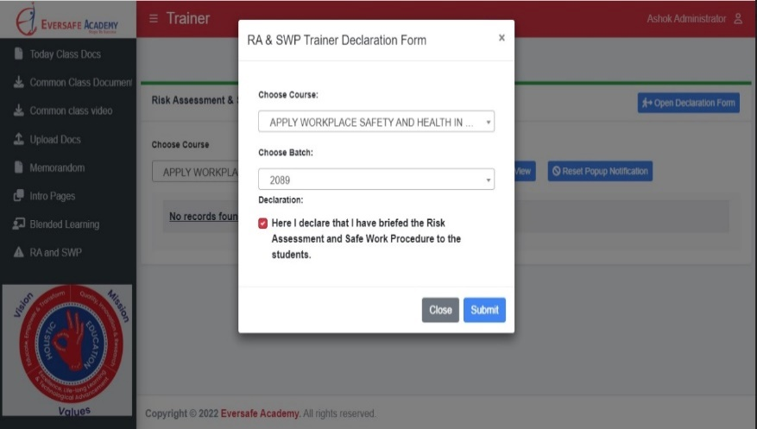



Launch “RA and SWP” from SSTM
Trainer to brief RA and SWP to Trainees (RA/SWP)
Go to Teacher-SSTM
Dear Trainer, Please brief practical RA/SWP to Students before lunch time.
System will lock the next session attendance, if you are not done so.
Thank you
1
Click “RA/SWP” tab
Choose Course
Choose Batch ID
Send Notification to all Students after briefing.
2
Student will receive
E-mail or SMS the “Risk Assessment and Safe Procedure Acknowledgement Form”
link, Student will have to
click the “Link” and acknowledge that they have attended the briefing and click “Submit”
www.eversafe.edu.sg

Slide 13
Importance of Wearing PPE During Practical Training Sessions
Personnel Protective Equipment - PPE is designed to protect against a range of hazards that may be present during practical training sessions.
As a WSH MANDATORY requirement, appropriate Personal Protective Equipment (PPE) must be worn during practical training sessions in our training center (workplace). We kindly request your full compliance with this matter.
All Trainers and Trainees,
Wearing personal protective equipment (PPE) during a training session is crucial to ensure the safety of the trainees and trainers.
By emphasizing the importance of PPE and to ensure that all Trainees and Trainers are adequately protected during the session.
This can lead to increased awareness of hazards and a greater focus on preventing accidents and injuries.

Slide 14

Mobile Phone Usage Policy
{mobile_usage_p1}
{mobile_usage_p2}
{mobile_usage_p3}
{mobile_usage_p4}

